Slide 1
Dynamic Arrays
Introduction to Amortized Analysis
Week 3 / Lecture 2
Franck Chauvel
axbit & NTNU
franck.chauvel@ntnu.no

Slide 2
Remember Arrays?
MEMORY:
Arrays
Contiguous memory allocation
Fixed-capacity
Variable length
What do we do when the array is full?
base address:
123
1
bucket
1
2
length
2
capacity
3
3
?
?

Slide 3
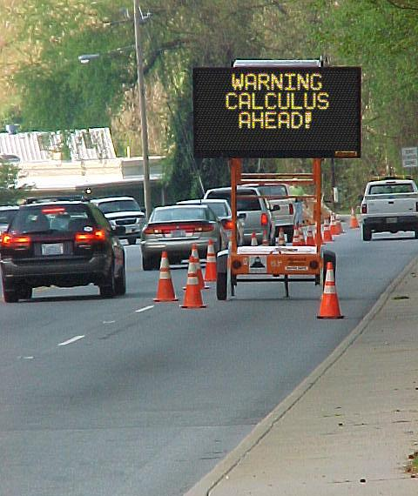
Agenda
Static Arrays
Dynamic Arrays
Amortized Analysis
Aggregate Method
Accounting method
Recap

Slide 4
Insertion Efficiency?
Time:
At the end: O(1)
Random O(n)
Requires shifting elements!
Space
O(1)
int static_push(Array* array, int value) {
if (is_full(array)) return 2;
array->length += 1;
array->content[array->length] = value;
}

Slide 5
Dynamic Arrays
Allocate more memory when we need!
When to grow/shrink?
How much to grow/shrink?
int dynamic_push(Array* array, int value) {
if (is_full(array)) {
Array* old_array = array->content;
array->capacity += 10;
array->content = malloc(array->capacity * sizeof(int));
for (int index=0 ; index<array->length ; index++) {
array->content[index] = old_array[index];
}
free(old_array);
}
array->length += 1;
array->content[array->length] = value;
}

Slide 6
Average Time?
An efficiency model:
A random variable:

Slide 7
What Does That Say?
 | Capacity
Length | c=2 | c=3 | c=4 | c=5 | c=100
0 | 1 | 1 | 1 | 1 | 1
1 | 1 | 1 | 1 | 1 | 1
2 | 4 | 1 | 1 | 1 | 1
3 |  | 5 | 1 | 1 | 1
4 |  |  | 6 | 1 | 1
5 |  |  |  | 7 | 1
100 |  |  |  |  | 102
Average | 2 | 2 | 2 | 2 | 2

Slide 8
What Does it Misses?
We don’t pick arrays at random
Sequence of operations
Over the same array
What happens once we have resized the array?
?
?
1
?
time = 1
full
1
2
time = 1
full
1
2
3
time = 4
full
1
2
3
4
time = 5
full
1
2
3
4
5
time = 6
full
1
2
3
4
5
6
time = 7

Slide 9
Amortized Analysis
Same data structure
Sequence of operations
3 methods
Aggregate method
Banker’s method
Physicist’s method
?
?
1
?
time = 1
full
1
2
time = 1
full
1
2
3
time = 4
full
1
2
3
4
time = 5
full
1
2
3
4
5
time = 6
full
1
2
3
4
5
6
time = 7

Slide 10
Amortized vs. Average
Average Case
Amortized
One operations
Many possible inputs
Probabilistic assumption
Many operations
One data structure
Often, for “house cleaning” in the data structure

Slide 11
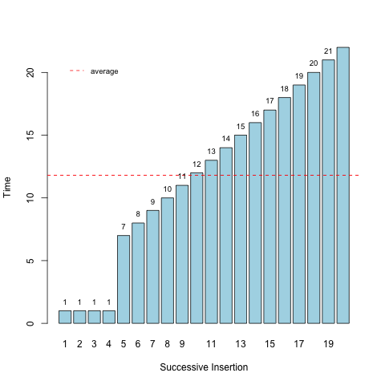
The Aggregate Method

Slide 12
The Aggregate method
An efficiency model:

Slide 13

The Banker’s Method
We sell our algorithms as a service
We pay for the CPU & Memory we use
Some operation are more expensive than other
How much shall we charge to make a living?

Slide 14
Banker’s method
Devise a “gain” for each operation
Show that the balance never gets negative
Your gain is your upper bound

Slide 15
Example: Adding k new buckets
int dynamic_push(Array* array, int value) {
if (is_full(array)) {
Array* old_array = array->content;
array->capacity += 5;
array->content = malloc(array->capacity * sizeof(int));
for (int index=0 ; index<array->length ; index++) {
array->content[index] = old_array[index];
}
free(old_array);
}
array->length += 1; // Prout
array->content[array->length] = value;
}

Slide 16

What Does it Cost?
time
copy
insertion
allocation
$k$: expansion
1
5
10
15
insertions

Slide 17
What Should we Charge?
time
copy
insertion
allocation
1
5
10
15
insertions

Slide 18
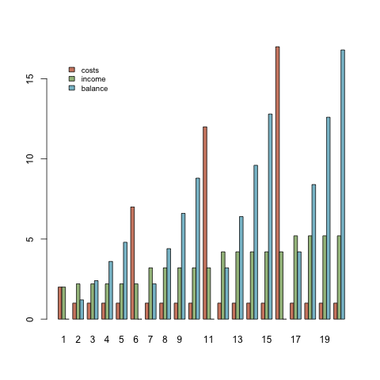
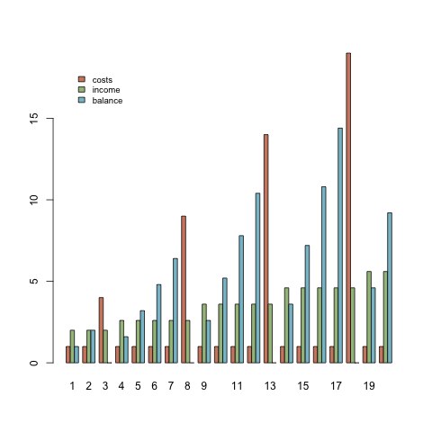
Does that Work?

Slide 19
How to Prove it?
Proof by induction
Two steps
Show it works for the first step
Assume no funds at first
Show that
Provided it work one step,
It works for the next

Slide 20
A Proof
Take it expansion by expansion
Step 1:
Show it works for the first expansion

Slide 21
A Proof
Take expansion by expansion
Step 2
If the balance is not negative after an expansion
It should remains non negative after the next

Slide 22
A Proof

Slide 23

About Calculus
Don’t fear Greek symbols
It is just a syntax
Understand
Work out examples

Slide 24
Recap
Dynamic Arrays
Allocate memory as we need
Amortized Analysis
Different from average analysis
Efficiency of a sequence of operations
Useful for self-adaptive data structures
3 Methods
Aggregate
Banker’s method
Physicist’s method

Slide 25
Questions, Comments, or Ideas?
Franck Chauvel
axbit & NTNU
franck.chauvel@ntnu.no

Slide 26
Run-length Encoding (RLE) Lab Session
list “runs” with their length
Implement:
convertion
insertion
deletion
search
compression ratio?
1 run
input array
1
1
3
4
5
6
6
6
6
6
3
3
2 x 1
1 x 4
5 x 6
2 x 3
1 x 3
1 x 5
2
1
1
3
1
4
1
5
5
6
2
3
output array

